Slide 1

Review 1
Quantum-Enhanced Fraud Detection
Project Category: RESEARCH
Guide Name Student Name & Registration Number
Dr. Nalini S
Assistant Professor
Dheeraj Sharma - RA2211027010017
Saket Bishnu - RA2211027010059

Slide 2
Abstract
Fraudulent transactions are a major challenge in banking, causing financial losses and security risks. Traditional machine learning models struggle with complex fraud patterns. Our project combines Quantum Machine Learning (QML) with classical models like Random Forest and SVM to improve fraud detection accuracy. By using Quantum Kernel Methods (QKM), we aim to enhance anomaly detection in banking transactions.

Slide 3
Introduction
With the rise in digital transactions, detecting fraudulent activities has become increasingly difficult. Traditional fraud detection models rely on pattern recognition, but they often fail to capture complex correlations in transaction data.
Our research explores how Quantum Computing (QC) can boost fraud detection by:
Enhancing feature space representation using quantum kernel tricks
Improving computational efficiency for large-scale transaction datasets
Detecting complex fraud patterns more accurately

Slide 4
Product Vision Statement
To develop a hybrid quantum-classical fraud detection model that significantly enhances fraud identification in banking transactions, ensuring security and efficiency in financial systems.

Slide 5
Product Backlogs
Product Backlogs (Features to be Developed)
Data Preprocessing – Handling imbalanced transaction data
Classical ML Model Implementation – Training and testing traditional models
Quantum Model Implementation – Using Quantum Kernel Methods with Qiskit
Performance Benchmarking – Comparing quantum-enhanced results with classical ML
System Optimization – Reducing computational costs and improving model efficiency

Slide 6
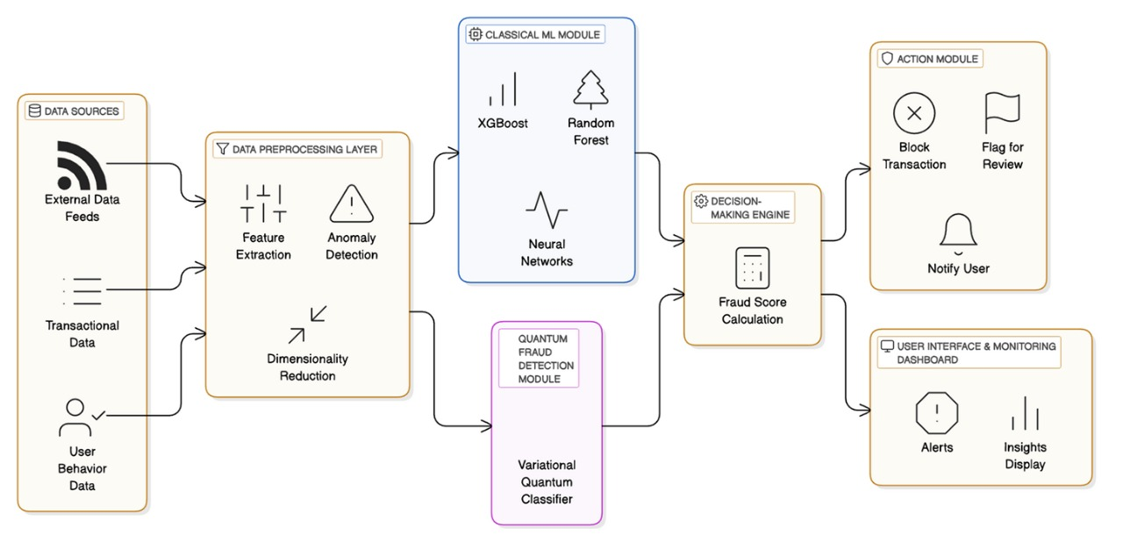
System Architecture Diagram

Slide 7
Project SDG
This project aligns with:
SDG 9: Industry, Innovation, and Infrastructure – By integrating Quantum Computing into fraud detection
SDG 16: Peace, Justice, and Strong Institutions – By enhancing security and reducing financial

Slide 8
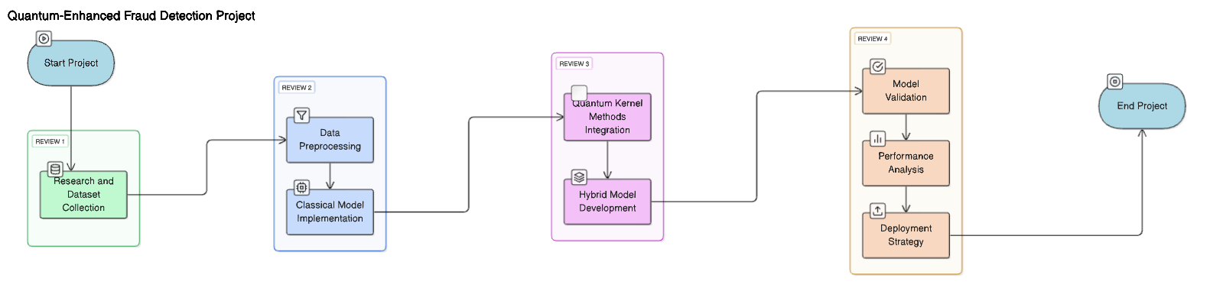
Product Roadmap/ Release Plan
Week 4-5 (Review 3)
Implement Quantum Kernel Methods (QKM)
Combine classical and quantum models
Optimize the hybrid model
Week 6-7 (Review 4 - Final Review)
Model validation and fine-tuning
Comparative performance analysis
Deployment strategy and report preparation
Week 1 (Review 1 - Completed)
Project title finalization
Research on existing fraud detection methods
Initial dataset collection
Week 2-3 (Review 2)
Data preprocessing and feature engineering
Implement classical models (Random Forest, SVM, Logistic Regression)
Baseline performance evaluation

Slide 9
References for Quantum-Enhanced Fraud Detection
Online Resources & Whitepapers
IBM Quantum Research - https://research.ibm.com/quantum
Google AI Quantum - https://ai.google/research/teams/quantum
Microsoft Quantum Blog - https://cloudblogs.microsoft.com/quantum
MIT Technology Review: "How Quantum Computing is Changing Financial Security" - https://www.technologyreview.com
2. Classical Machine Learning in Fraud Detection
Zhang, Y., & Han, X. (2020). "Application of machine learning in fraud detection." Journal of Risk and Financial Management, 13(4), 74.
Mahmoudi, F., & Duman, E. (2015). "Detecting credit card fraud by Modified Fisher Discriminant Function and Support Vector Machine." Expert Systems with Applications, 42(5), 2510-2520.
3. Quantum Machine Learning for Fraud Detection
Schuld, M., Sinayskiy, I., & Petruccione, F. (2014). "The quest for a quantum neural network." Quantum Information Processing, 13(11), 2567-2586. [DOI: 10.1007/s11128-014-0809-8]
Lloyd, S., Mohseni, M., & Rebentrost, P. (2013). "Quantum algorithms for supervised and unsupervised machine learning." arXiv preprint arXiv:1307.0411.
4. Hybrid Quantum-Classical Approaches
Benedetti, M., Lloyd, E., Sack, S., & Fiorentini, M. (2019). "Parameterized quantum circuits as machine learning models." Quantum Science and Technology, 4(4), 043001.
5. Security and Compliance in Banking Fraud Detection
Basel Committee on Banking Supervision. (2021). "Principles for the sound management of operational risk." Bank for International Settlements.
GDPR Compliance Guide. (2022). "How financial institutions can ensure fraud detection aligns with GDPR." European Commission Report on Data Privacy.

Slide 10
Thank You

